Slide 1



Target tree
Remote-sensing pixel

Slide 2
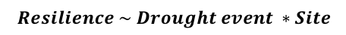
SPEI-12
2005
2012
1901
2016
Identification of severe drought-events
Characterization of severe drought events
1
2
SPEI-12; Regional Climatic data
Duration, severity, intensity
Resilience metrics
Drought
BAI
Resilience metrics
EVI
1
Resistance; Recovery ; Resilience
Drought severity
Year
Robust ANOVAs
$$Resilience \sim Drought event ∗Site$$
3

Slide 3
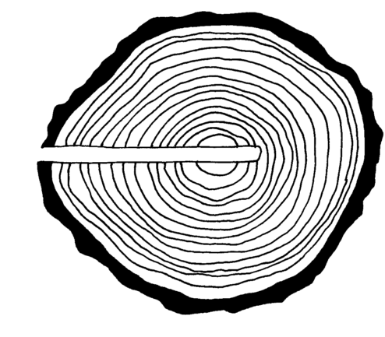
Drought impacts
Non-climatic disturbances
Resilience
Temporal trends
Resistance; Recovery; Resilience
Remote sensing
EVI_{sa}
EVI
EVI
pixels
Mann-Kendall
2005, 2012
1
3
Dendroecology
Short-term
Long-term
RWI
TRW GC
target
trees
BAI
BAI
Mean BAI
site chronologies
Mean RWI
site chronologies
Site-disturbance chronologies
Most severe droughts (n=8)
Site-disturbance chronologies
2005, 2012
1
3
2

Slide 4


Slide 5
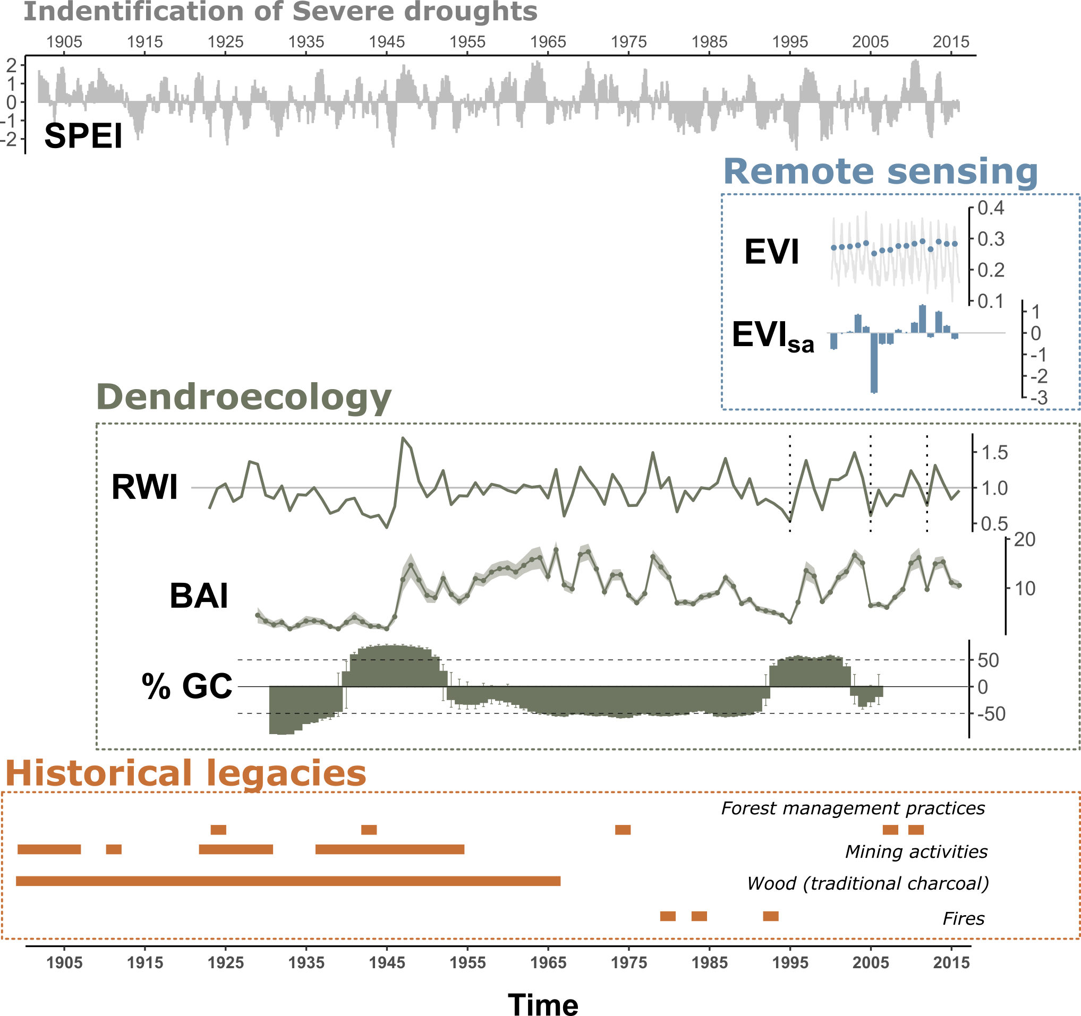
a
b
Impacts
Responses
at rear-edge
within rear-edge
Climate impacts
Non-climatic disturbances
Short-term
Long-term
EVI
resilience metrics
_{2005, 2012}
Mann-Kendall
temporal trend
EVI_{sa}
Comparison
between
populations
1
3
Mean RWI
site chronologies
BAI
resilience metrics
_{most severe droughts (n=8)}
Temporal trend
4
TRW GC
site-disturbance chronologies
2
Review of historical documents
to infer anthropogenic alteration of habitat

